Slide 1
Thermoregulation adaptations Notes
Describe adaptations (structural, behavioural & physiological) of endotherms & ectotherms that control heat exchange & metabolic activity
Compare adaptations of endotherms & ectotherms that control heat exchange & metabolic activity
Use negative feedback to describe how organisms control heat exchange and metabolic activity

Slide 2
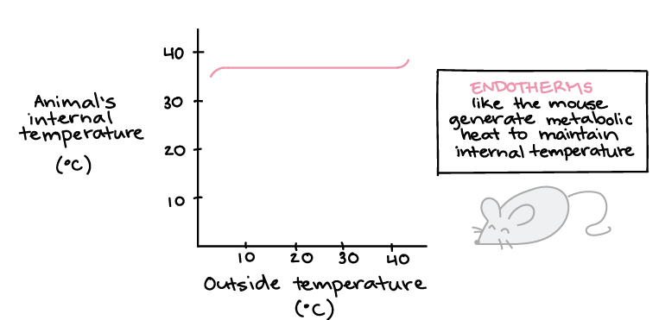
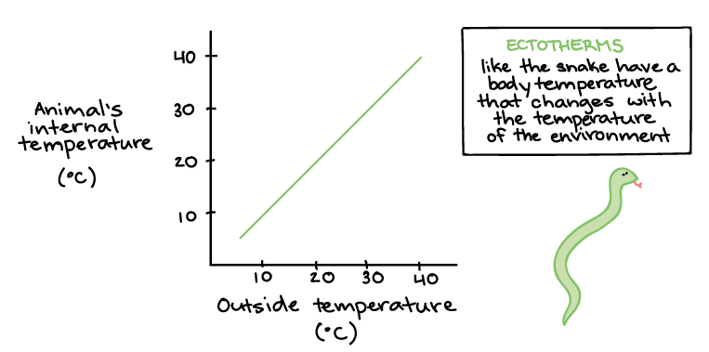
Homeostasis
Syllabus:
Homeostasis is the process by which the body maintains a relatively constant internal environment; it involves a stimulus-response model in which change in external or internal environmental conditions is detected and appropriate responses occur via negative feedback
Changes in an organism’s metabolic activity, in addition to structural features and changes in physiological processes and behaviour, enable the organism to maintain its internal environment within tolerance limits (temperature, nitrogenous waste, water, salts, and gases)
Thermoregulatory mechanisms include structural features, behavioural responses and physiological mechanisms to control heat exchange and metabolic activity; animals can be endothermic or ectothermic
1. Use the negative feedback model to describe how an endotherm thermoregulates
2. Describe the structural, behavioural and physiological mechanisms that endotherms and ectotherms use to control heat exchange and metabolic activity (thermoregulation)
3. Compare the structural, behavioural and physiological mechanisms that endotherms and ectotherms use to control heat exchange and metabolic activity (thermoregulation)
Recap:
The 2 strategies to thermoregulate
Essential
Question:

Slide 3
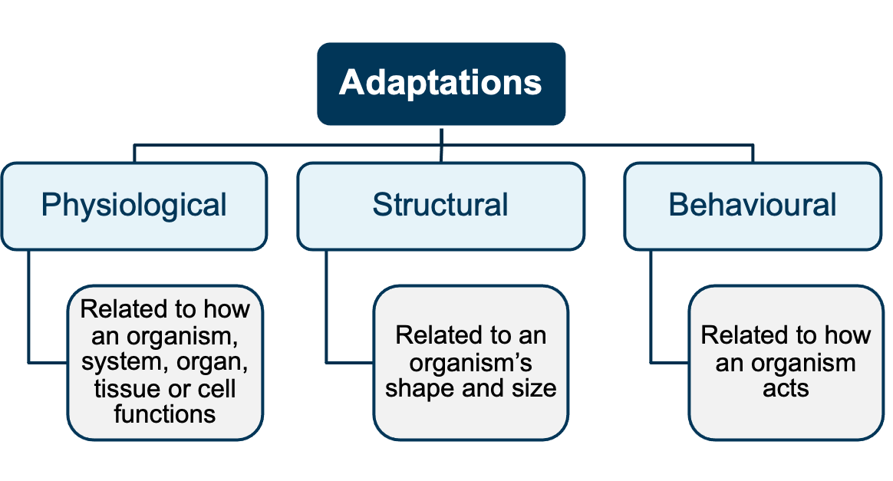
Recap: Define adaption, and describe the three classifications of adaptations

Slide 4
Topic Question 1: State behavioural and physiological mechanisms of endotherm and ectotherms that control heat exchange and metabolic activity

Slide 5
Topic Question 2: State structural features of endotherm and ectotherms that control heat exchange
Check your understanding in a hot environment is it better to have a large body or a small body body. Why?

Slide 6
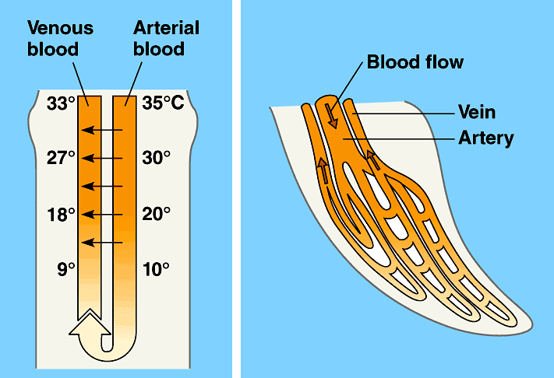
Topic Question 3: Describe how counter current heat exchange can help reduce heat exchange with the environment
Check your understanding. Complete the diagram below to describe how counter current heat exchange reduces heat lost to the environment
_____°C. _____°C. _____°C
_____°C. _____°C. _____°C

Slide 7
Topic Question 4: Use negative feedback loops to show the the receptors, modulator and effectors involved in thermoregulation when body temperature rises above tolerance limits
STIMULUS
Change in the environment that causes system to operate. (Above or below the normal).
RECEPTOR
Detects change
MODULATOR
Control centre responsible for processing information received from receptor & sending information to effector
FEEDBACK
Achieved because original stimulus has been changed by the response
RESPONSE
Action and processes (mechanism) of the effector
EFFECTOR
Carries out response counteracting effect of stimulus

Slide 8
Topic Question 5: Use negative feedback loops to show the the receptors, modulator and effectors involved in thermoregulation when body temperature falls below tolerance limits
STIMULUS
Change in the environment that causes system to operate. (Above or below the normal).
RECEPTOR
Detects change
MODULATOR
Control centre responsible for processing information received from receptor & sending information to effector
FEEDBACK
Achieved because original stimulus has been changed by the response
RESPONSE
Action and processes (mechanism) of the effector
EFFECTOR
Carries out response counteracting effect of stimulus

Slide 9
Topic Question 6: Define the terms torpor, hibernation, diurnal and aestivation and explain how these mechanisms help endotherms and ectotherms control heat loss and metabolic activity

Slide 10
Sum it up! For each of the three classifications of adaptations, give examples of adaptations endotherm employ to control heat exchange and metabolic activity

Slide 11
Sum it up! For each of the three classifications of adaptations, give examples of adaptations ectotherm employ to control heat exchange and metabolic activity

